Slide 1
Node.js deep-dive
and how things can go wrong

Slide 2
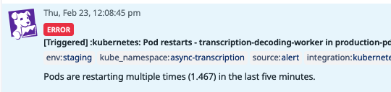
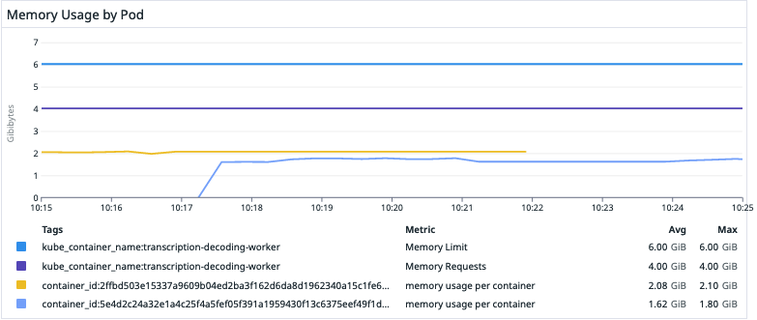
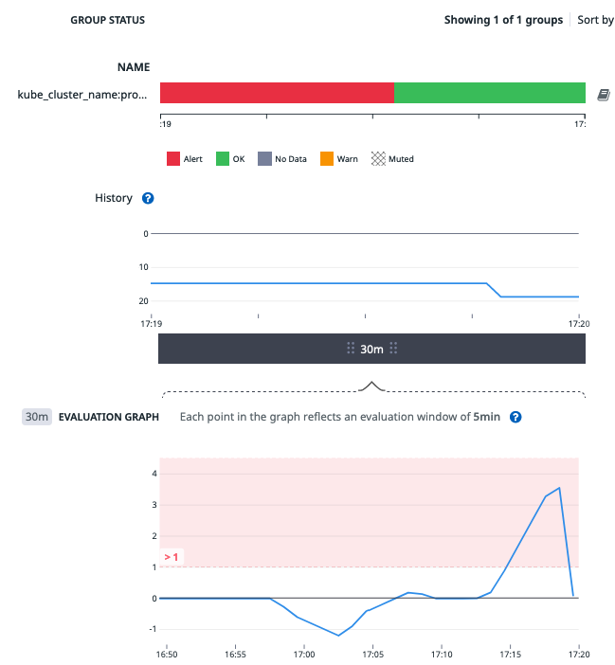
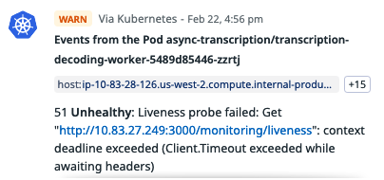
What did go wrong?

Slide 3
Why Node.js? What problem is it trying to solve?
Web server problem: handle more connections at the same time
Classic web server (Java) | Node.js server (libuv)
separate thread for each connection | 1 thread for all connections
threads reserved for the duration of the whole connection - mostly waiting | use kernel directly - system calls to poll for I/O async operations to monitoring sockets for read/write
~1.000s of connections | ~10.000s of connections
Higher resource cost per connections threads are heavy-weight OS resource does not scale well | lower resource cost per connection kernel operations instead of threads scales better

Slide 4
Main memory read vs Network round trip latency (US-EU)
100 ns
150,000,000 ns
150 ms

Slide 5
Event loop - main thread to handle connections
tell kernel to monitor some sockets
kernel signals back when sockets are ready to read/write
check & read/write in a loop
Node.js (libuv)
OS kernel
interest list - monitored sockets
ready list - sockets ready for I/O
epoll

Slide 6
So is Node.js single-threaded?
Well yes, and no!
Yes - 1 main thread for handling network connections (*and other things)
No - libuv also has a threadpool, to execute expensive tasks outside the main thread, to avoid blocking it

Slide 7
Where is my code being executed?
Main Thread
js code
manages kernel async operations
OS/kernel async operations
network operations (tcp/udp)
stdin/stdout/stderr
pipes
signals
Background Threads
filesystem operations (no async kernel operations)
long-running CPU intensive (encryption/compression)
DNS functions (lookup)
Other user specified code (via uv_queue_work)
voiceai-engine (node-add-on api C++)

Slide 8
Where is my code being executed?
Main Thread === Event Loop
Background Threads === Worker Pool

Slide 9
What can go wrong?
Main Thread
Blocking the Main thread
executing blocking or long-running code in the main thread
blocks the loop, does not allow the loop to check for network IO
can result in degraded performance or complete denial of service
Background Threads
Threadpool Contention
executing long-running tasks in the threadpool, will occupy one of the threads until the task is completed
can result in degraded performance or complete denial of service

Slide 10
What did go wrong?
Why did it only happen sometimes?

Slide 11
Where is our code being executed?
Main Thread
js code
manages kernel async operations
OS/kernel async operations
network operations (tcp/udp)
stdin/stdout/stderr
pipes
signals
Background Threads (2)
filesystem operations (no async kernel operations)
long-running CPU intensive (encryption/compression)
DNS functions (lookup)
Other user specified code (via uv_queue_work)
voiceai-engine (node-add-on api C++)

Slide 12
What did go wrong?
Main Thread
liveness endpoint - networking (sqs.getQueueAttributes)
Background Threads (2)
voiceai-engine decoding - thread 1
voiceai-engine decoding - thread 2

Slide 13
What did go wrong?
Main Thread
liveness endpoint - networking (sqs.getQueueAttributes)
Background Threads (2)
Threadpool Contention??
voiceai-engine decoding - thread 1
voiceai-engine decoding - thread 2

Slide 14
Key Question!
Why does the liveness endpoint code
sometimes execute on the Background Threads (Worker Pool)
and not always in the Main Thread (Event Loop)?

Slide 15
What did go wrong?
Main Thread
liveness endpoint - networking (sqs.getQueueAttributes)
Background Threads (2)
Threadpool Contention??
voiceai-engine decoding - thread 1
voiceai-engine decoding - thread 2
liveness endpoint??

Slide 16
What did go wrong?
Main Thread
liveness endpoint - networking (sqs.getQueueAttributes)
Background Threads (2)
Threadpool Contention
voiceai-engine decoding - thread 1
voiceai-engine decoding - thread 2
liveness endpoint - dns lookup (queue url)
dns caching (making reproducibility hard)

Slide 17
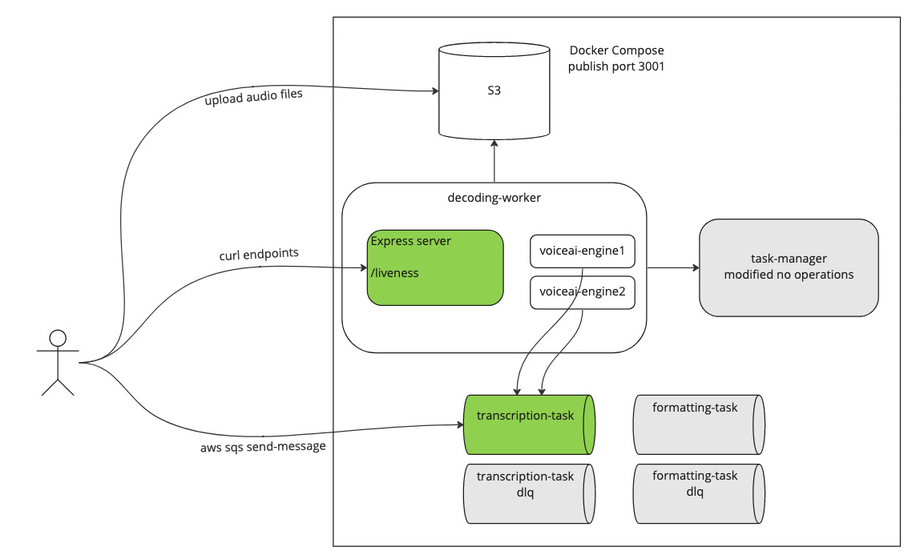
Demo

Slide 18
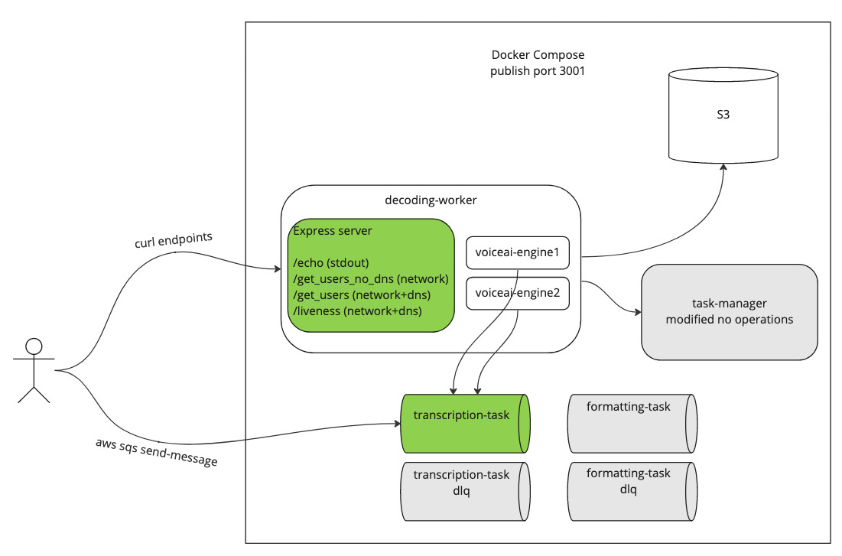
Demo

Slide 19
Solution 1
Main Thread
liveness endpoint - networking (sqs.getQueueAttributes)
Background Threads (2 → 4)
voiceai-engine decoding - thread 1
voiceai-engine decoding - thread 2
liveness endpoint - dns lookup (queue url)
dns is cached

Slide 20
Solution 2
Main Thread
liveness endpoint - networking only or other main thread operations
Background Threads (2)
voiceai-engine decoding - thread 1
voiceai-engine decoding - thread 2

Slide 21
What else can go wrong?
Main Thread
Datadog metrics (statsD) - networking
Background Threads (2)
Threadpool Contention
voiceai-engine decoding - thread 1
voiceai-engine decoding - thread 2
Datadog metrics (statsD) - dns lookup

Slide 22
References
Node.js docs - Don’t block the event loop
libuv docs - Design overview
Youtube - Nodejs not so single threaded
Making http calls without dns.lookup

